Slide 1
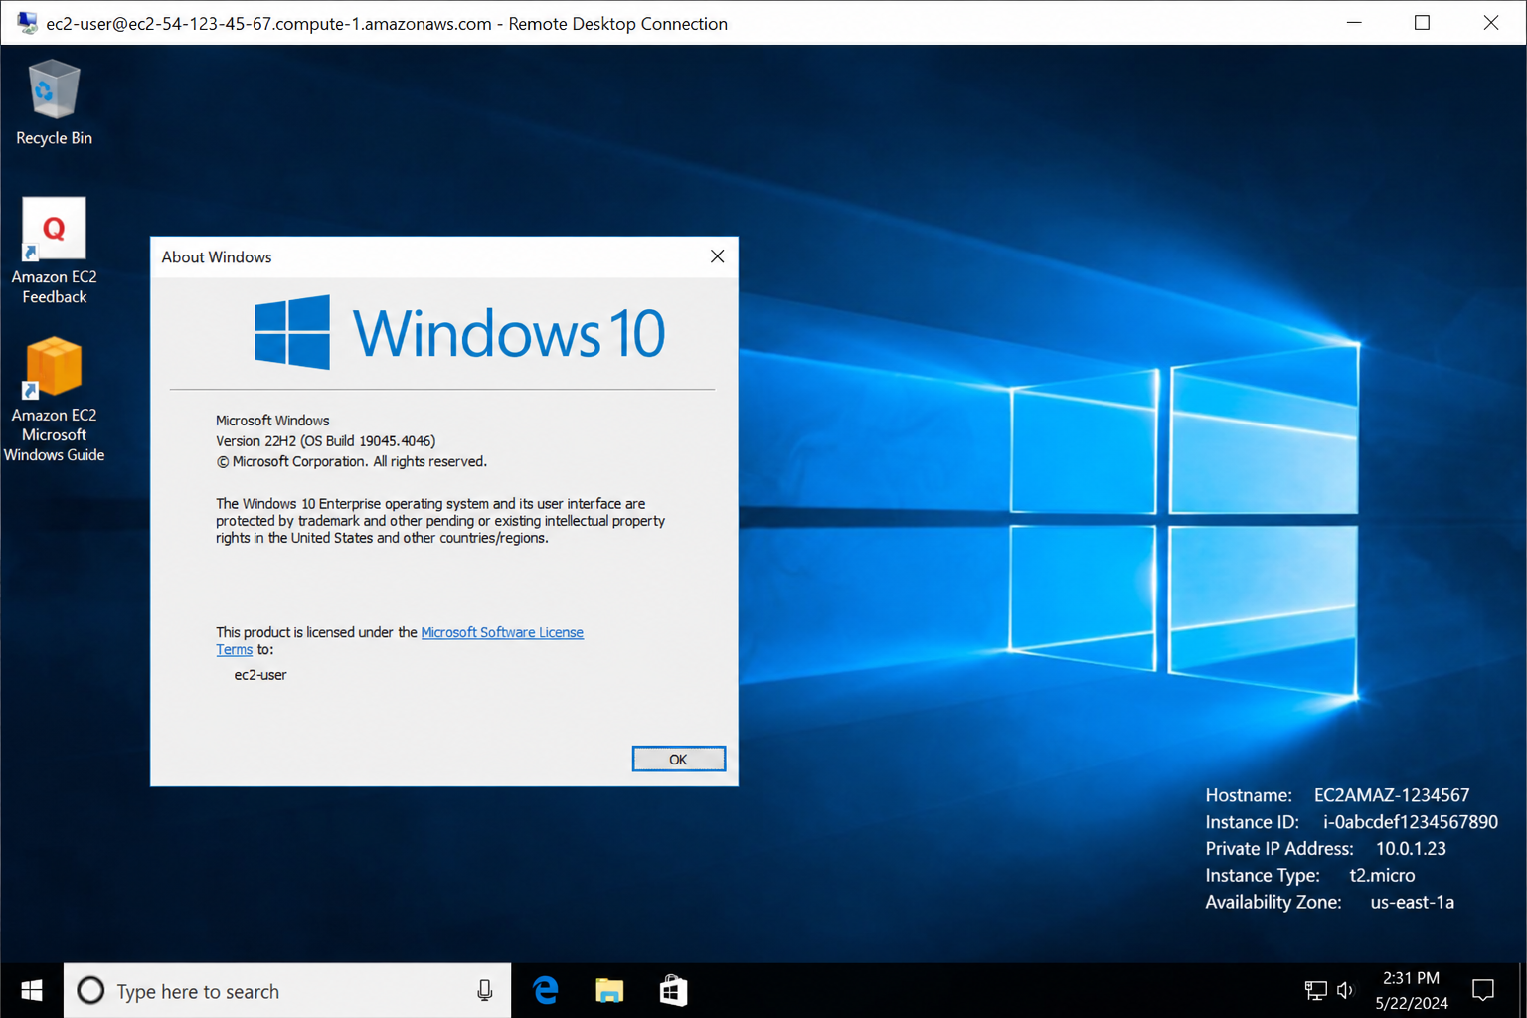
Create RDP on AWS
Olalekan Omotayo(Yahwehboy)

Slide 2
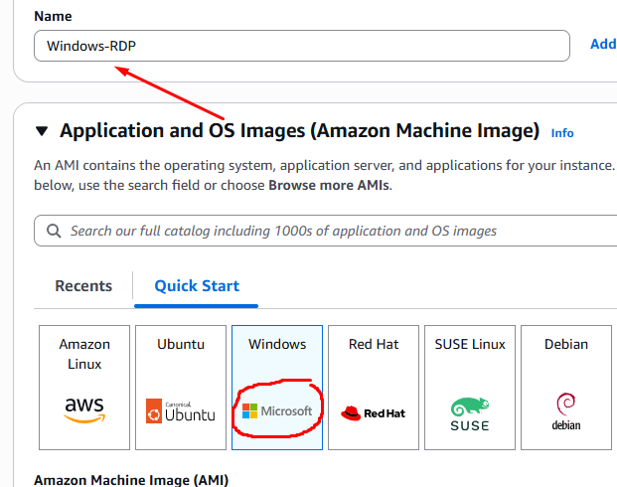
Launch a Windows EC2 Instance
Sign in to the AWS Management Console and go to the EC2 Dashboard.
Click Launch Instance.
Name you instance (e.g., "Windows-RDP").
Under Application and OS Images, select a Windows Server AMI (e.g., Windows Server 2025 Base).
Choose an instance type (e.g., t2.micro for free tier)
Create a Key pair and download the .pem file. This is critical for retrieving the password.

Slide 3
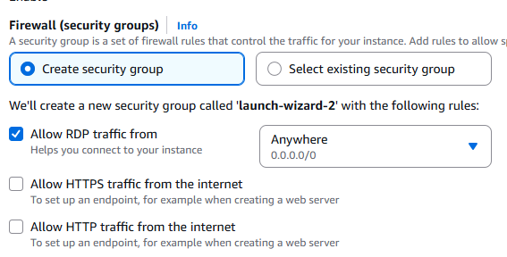
Configure Security Group (Enable RDP)
Ensure the security group allows inbound traffic on port 3389 (RDP).
Set the Source to "My IP" for better security, or "Anywhere" (0.0.0.0/0) if your IP changes frequently.

Slide 4
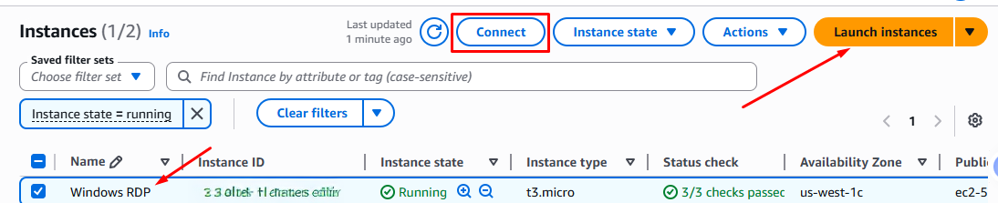
Launch and Connect
Click Launch Instance
Go to instances, select your new instance, and click Connect.
Select the RDP client tab and click Download remote desktop file.

Slide 5
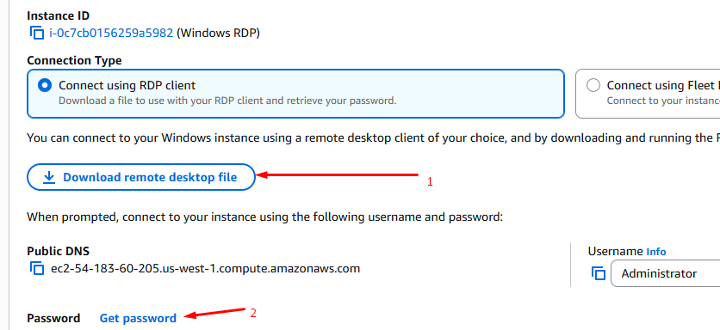
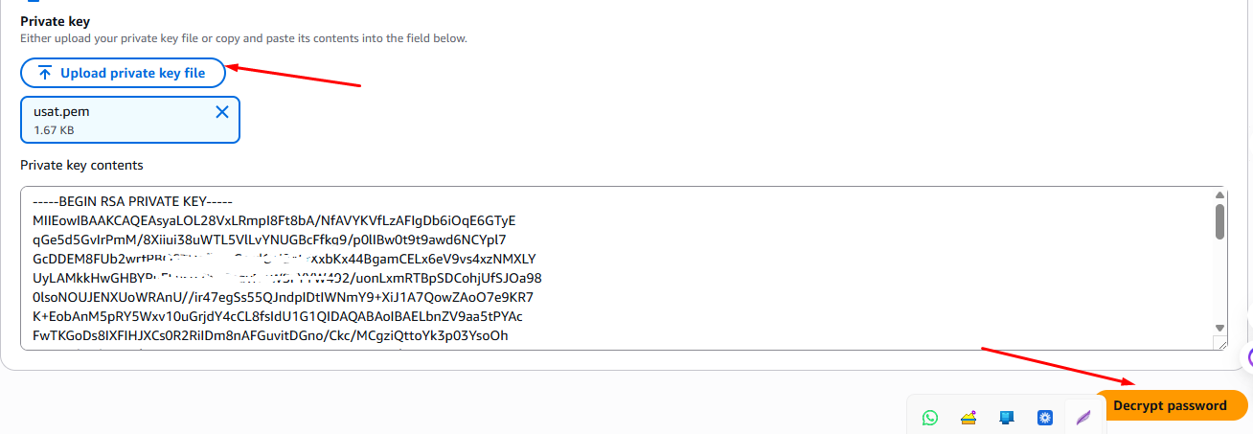
Retrieve Password and Login
In the "Connect to instance" screen, click Get password.
Upload your .pem key file and click Decrypt Password
Open the downloaded RDP file, enter the username (Administrator) and the decrypted password

